Slide 1
Be Safe Out There!
Cyber Security Threats and Simple Steps to Protect Yourself
Penny Austin
Tennessee Comptroller of the Treasury
Notes:
Your interest today shows that you are aware of the need to educate yourselves about the threats that are out there. And unfortunately, there are many.
Today’s presentation is not going to dive into firewall configurations or intrusion detection systems but instead will focus on another very critical component of your information system environment – you the users.

Slide 2
Security Awareness Training
Why is it so important?
It is estimated that 2/3 of successful cyber attacks resulted from poor employee practices.
Notes:
Why is security awareness training so important? Many studies estimate that around 2/3 of attacks are the result of poor user practices.
And I believe that by periodically reminding ourselves of the threats out there and the red flags that can identify those threats, we have a much better chance of slowing down and recognizing those threats when we encounter them. The more we discuss the schemes that the bad actors use, the louder that little voice in the back of your head saying “Wait a minute, think before your click” will become when you are receive an unexpected email.

Slide 3
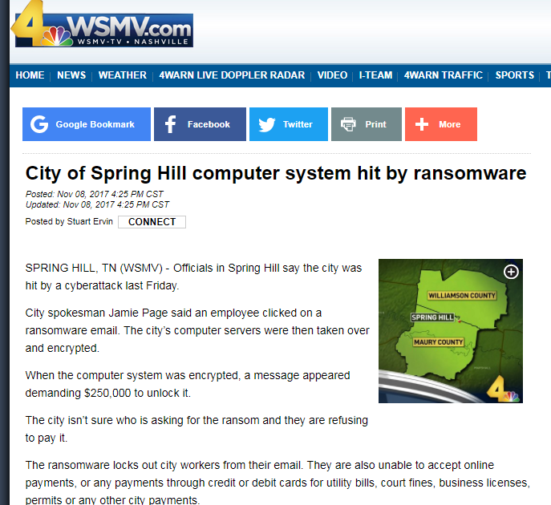

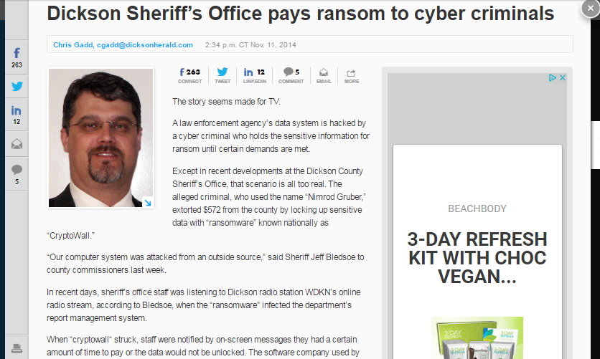
Targets
It can happen to you!
Notes:
And unfortunately, it can happen to you.
Local governments have become preferred targets in the last few years. While large cities like Atlanta have been hit, smaller local governments have seen their share of attacks – many here in Tennessee. Maybe the most well-known attack happened in the City of Spring Hill. Spring Hill received a ransomware attack in November 2017 that caused much pain when an employee fell victim to a phishing attack. I attended a presentation that someone from Spring Hill had given regarding the incident. I am not sure of the final costs to the city, but I remember hearing estimates of around $100,000. And that was only the monetary outlay. Hundreds of hours of overtime went into restoring the system and the records. Because their backup data was also encrypted in the attack, payroll records had to be recreated. The city’s utility billing software was unavailable for quite some time, so they had to ask residents to send in payments based on previous bill amounts. Needless to say, I am sure it was a painful experience.
And I don’t mention this to shame anyone for falling victim to these attacks but to show you how easily it can happen. Say you are busy and focused on an important task such as maybe putting together a budget. You are working away when an email pops up. You want to get that off your plate as soon as possible so you can get back to the budget, so you quickly respond without giving it much thought. And then the attacker has your information, or you have given them access to government funds. So again, I think if we discuss this often and train that little voice, we are more likely to recognize a threat when it is received.

Slide 4
What’s out there?
Cyber Attacks
Phishing – Email is great isn’t it?
Vishing and Smishing – Phishing but voice calls and text messages.
Social Media attacks – Friend or family member suddenly stuck in a foreign country and needs money?
Malware/Ransomware – You don’t need those tax records, do you?
Notes:
So what is out there?
If we were in-person, I would ask you to raise your hand if you think you have never been targeted with an attack.
If someone raised a hand, I was going to be a little skeptical. There are so many techniques and tools that can be used by the bad actors to try to steal your money or your information. I know that I get several a month at either work or home.
So today I want to discuss just a few of the schemes used so that you can more easily recognize them when you are targeted. Schemes include
phishing, vishing, smishing, social media attacks, and ransomware.
Please note that this is by no means an exhaustive lists of the kinds of attacks, but these are the ones we will discuss today.

Slide 5
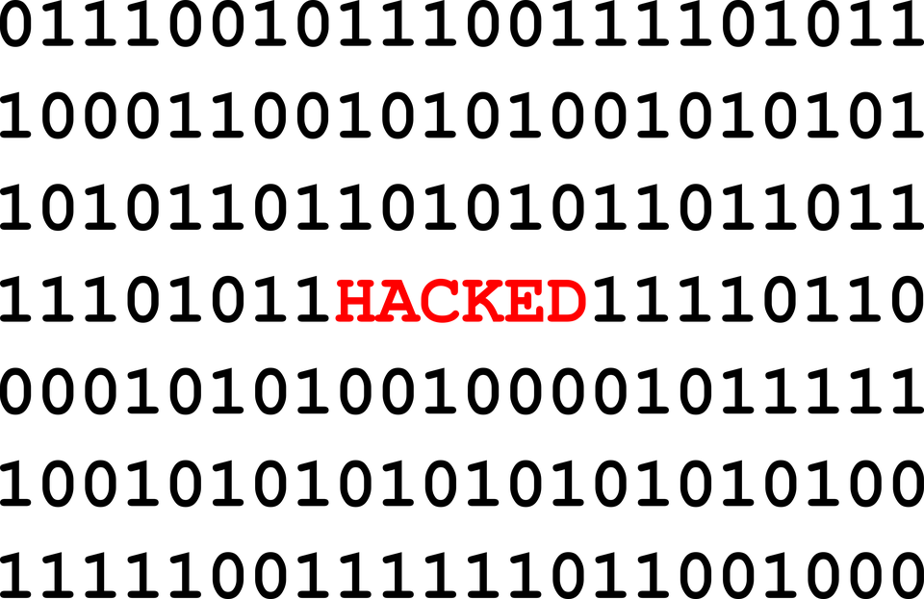
Cyber Attacks
How they attack
Common methods
  Social Attacks – ~33%
    Phishing – Email – ~32%
    Stolen credentials – ~29%
    Business Email Compromise
  Malware – ~28%
    Email attachments
    Malicious websites
Other method
  Hacking – exploiting unpatched or incorrectly configured systems
Notes:
Some Statistics - Each year Verizon issues a Data Breach Investigation Report. In their 2019 report, they estimated that around 33% of attacks are social attacks where the criminal acquires information from you via emails. Twenty-eight percent occurred because someone clicked on an email attachment and visited a malicious website.
Criminals also exploit systems that are not properly patched or updated.

Slide 6
Phishing
It’s everywhere
It’s not going anywhere
3.4 Billion fake emails a day!
Notes:
Let’s talk about phishing. I am sure everyone knows that phishing is the fraudulent practice of sending emails purporting to be from reputable companies or individuals in order to induce individuals to reveal personal information, such as passwords and credit card numbers or to click on a malicious link or attachment.
It is estimated that 3.4 billion fake emails are sent everyday. So if you have never received one, maybe you should play the lottery.

Slide 7
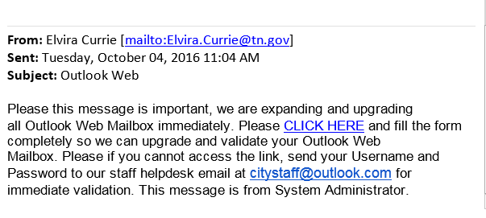
Phishing
Notes:
I want to share some common themes that you see in phishing emails.
This example is from quite a while back, but I still receive similar emails. This email addresses my Outlook account. I do have an Outlook account. And if you notice, this email appears to be coming from someone at a tn.gov address. So at first glance this seems to be a valid email coming from a State of Tennessee employee. However, when I read the email, I see some red flags. The most obvious one is the request to send my username and password. Your system administrator will never ask you for your credentials. You also notice the use of the word “immediately.” Another red flag is the use of urgency. The attacker wants you to feel rushed so that you respond quickly without thinking it through.
Unfortunately, we did have a couple of users from our office, click on this link which took them to a form where they entered their login and password and submitted the form to the attackers. Immediately after doing so, they realized that had fallen prey to the attack and changed their login and password and reported the incident to our IT staff so they could more closely monitor our network for suspicious activity.

Slide 8
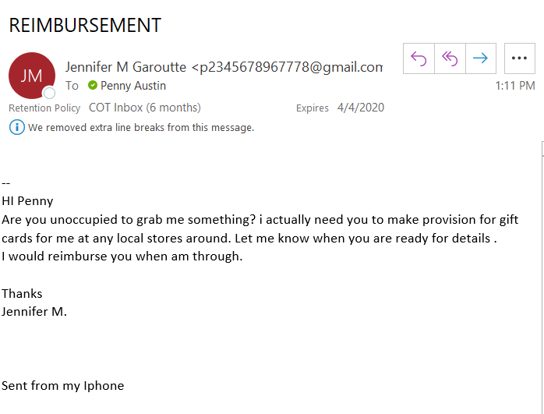
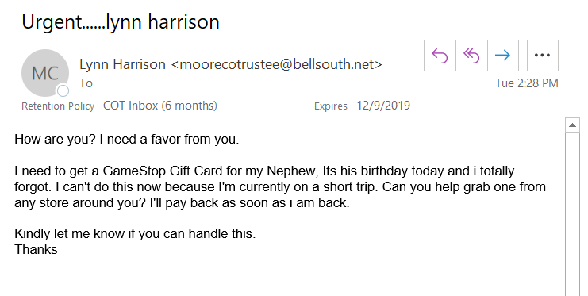
Phishing
Notes:
Here is an example of a scheme we have seen a lot of recently. This is a request to buy gift cards. This particular email was sent to me from someone posing as the president of an organization where I serve as an officer. What are some clues here? The first one I notice is the strange email address. Also note the grammar mistakes and awkward wording. “Need you to make provision for gift cards” I would reimburse you when am through.”
This attacker had most likely gone to our organization’s website and gotten my email address and Jennifer’s name from the directory of officers listed. Because they learned that we had a business relationship, they hoped I would trust the email and respond. This type of phishing is sometimes referred to a business email compromise.
I have heard of a few county employees that have responded to this scheme. They receive an email that appears to come from someone in their office asking them to buy cards. They purchase the gift cards and then supply the attacker with the codes on the back of the cards that the attacker uses to make online purchases.

Slide 9
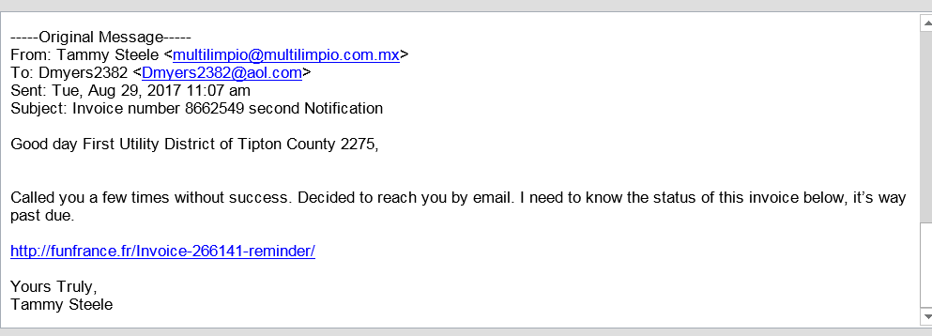
Phishing
Notes:
This is another example of business email compromise.
Tammy Steele works for our office and has a business relationship with the utility districts. The attacker somehow learned about this relationship and tried to use it in the attack. Fortunately, in this situation, the individual at the utility department recognized red flags and did not respond to the email. Of course, the attacker’s hope was that the target would click on the link which would download malicious software onto the machine.
Red flags here include the odd email address and the fact that the email discussed an invoice. The utility districts do not pay us, so this request seemed odd. However, you would not believe the number of individuals who might still click on this out of curiosity. Another flag here is the tone of the email. It is very casual. Tammy’s emails would always have a professional tone, so this seemed odd to the recipient as well.

Slide 10
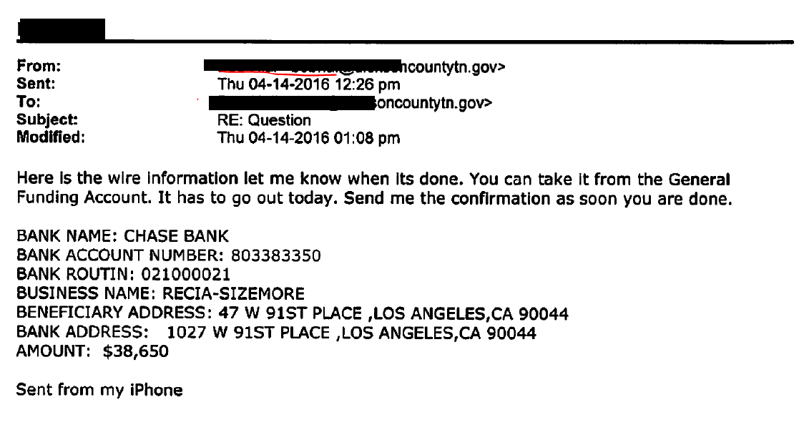
Phishing
Notes:
One last example.
This particular email exchange resulted in over $38,000 of county funds being transferred to the attacker’s bank account. In this case, the county finance director received an email from what appeared to be the county mayor’s email address asking him to wire money. What you are seeing here is only one email from what was a very lengthy email thread back and forth. It started out with “hey I need you to wire some money. I will give you the details later.” Then a reply from the finance director asking the purpose of the wire transfer. The attacker posing as the county mayor responds that It is for consulting. I will send you the invoice later. Etc etc. This attacker was actually investing a little time into the scheme by keeping up the email correspondence. The school department in the same county received a similar email but for some reason the attacker only requested $19,000 which they did wire. Maybe the attacker felt a little more guilty about stealing from the children. Law enforcement did get involved and but the bank account that the money was wired to had already been closed. The county was able to recover the funds less a deductible from their insurance company. I will discuss insurance later in the presentation.
What are some red flags here? We have talked about the odd email address. Well, in this situation, the attacker had spoofed the county mayor’s email address so that it looked valid. This is easily done. However, if you hover over the email address with your mouse, it will usually display the true email address. This email also emphasized this sense of urgency. “It has to go out today.” Also, look at the language used “General Funding Account.” We use the term General Fund in Tennessee governments.

Slide 11
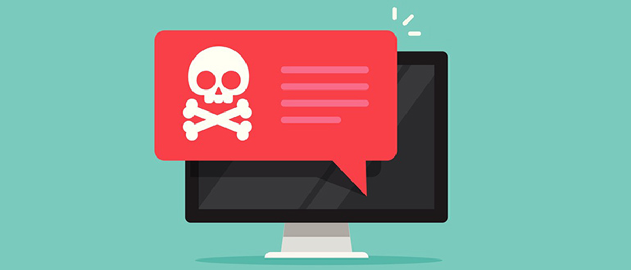
PHISHING
Other Common Schemes
Requests for payroll information
Requests to change bank account routing numbers for employees and vendors
Notes:
I don’t have examples of these but the other schemes we are seeing relate to payroll. These are business email compromises. One involves emails to payroll clerks that appear to be coming from their supervisors that request W-2 information. There was an incident a few years ago where a payroll clerk received an email from whom she thought was the director of schools requesting payroll information. The clerk emailed the w-2’s of the entire school department out to the attacker thinking he was the director.
Another scheme relates to routing numbers. An email is received by the clerk from an official’s email address. The email requests that a change be made to the official’s bank account information in the payroll system. The clerk makes the change and then when payday rolls around, the clerk receives a call from the official asking why they didn’t get paid.
Of course, the funds have gone into the bad guy’s account instead.
If your office does not already have a method for verifying changes to bank account information, I suggest that you put one in place, so this doesn’t happen in your government.

Slide 12
Phishing Red Flags
Sense of urgency
Spelling or grammar mistakes
Unrecognized email addresses
  Amazon.com vs Amazon.com.biz
Fictitious Website Links
  BankofAmerica.com vs. Bankofamerica.com.co.ru
Unfamiliar tone or language
Request for sensitive information
Notes:
So let’s review some of the red flags that you might see.
The sense of urgency – They want you to respond quickly without thinking.
Spelling and grammar mistakes – Many of the attacks do not originate from countries where English is the native language. But I will say that attackers are starting to use grammar check more often.
Unrecognized email addresses – Remember to hover over those email addresses.
Fictitious website links: I didn’t have an example of this one but again when you see a link in an email, hover over it to make sure it directs you to the correct address. That .ru on the end of this example lets you know that the site originates in Russia.
Unfamiliar tone and language
Request for sensitive information – If you receive an email request sensitive information, just pick up the phone and call the requestor to make sure the email is legitimate. It is also a good practice to create a new email typing in the requestor’s known true email address instead of hitting reply. Emails can be configured so that the reply is sent to an address other than that of the sender.

Slide 13
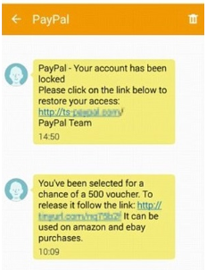
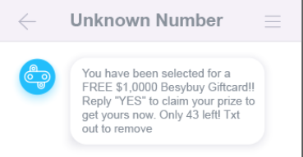
Smishing Examples
Notes:
I am not going to spend much time on this but these are some examples of those texts you get from attackers. These have some of the same red flags as the phishing emails. Many have a sense of urgency “only 43 left” or that something bad will happen if you don’t respond. These are similar to the vishing phone calls you receive from someone claiming that your social security number has been suspended or the IRS is freezing your accounts.

Slide 14

Social Media
“Try our new app for getting deals, click this link”
“Mom, I’m stuck in customs in France and need $5000 dollars to pay some fees”
It’s a lot like phishing, but on Facebook, Twitter, Snapchat, etc.
Notes:
Also just realize that you can also be targeted on social media as well.

Slide 15
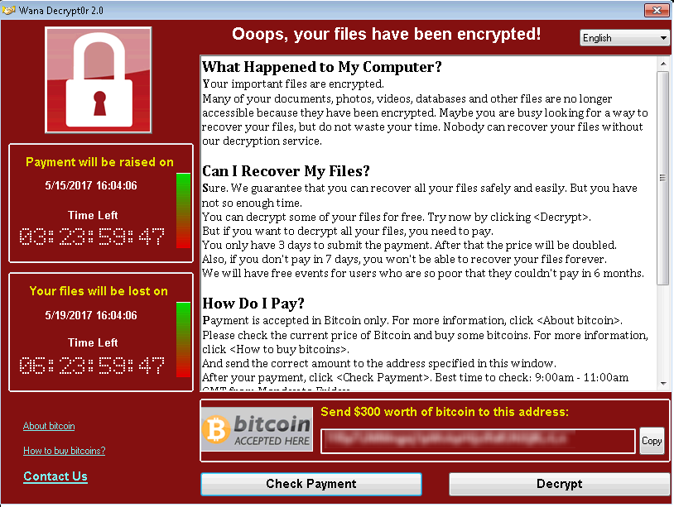
Ransomware
Ransomware will encrypt files on your computer and then give you directions to send money to the attackers.
There is a chance that paying the ransom will not get your files back.
Notes:
Let’s switch gears to ransomware.
This gets a lot of news coverage because its use is really on the uptick and governments are often a favorite target. I mentioned Spring Hill earlier and there have also been several other attacks of Tennessee local governments.
If any one is not familiar with ransomware, this is malicious software that encrypts your files or steals your data. The attacker then requests payment to unencrypt your files or send back your data. It also uses a sense of urgency to try to get you to react quickly. You can see the count down clock on this example. Payment is usually requested in cryptocurrency such as bitcoin because it is difficult if not impossible to trace.
And some reports indicate that even if you pay the ransom, you may not get your data back.

Slide 16
Ransomware
$338,700
$36,295
Notes:
Depending on what think tank’s research you look at, governments that are victims of ransomware are asked to pay almost 10 times as much as the private sector…
The average ransom for a government victim is almost $340,000.
The average ransom for all other victims is a little over $36,000.
These costs just reflect the ransom and don’t include the cost associated with restoring data or updating your e-mail services and your network.

Slide 17
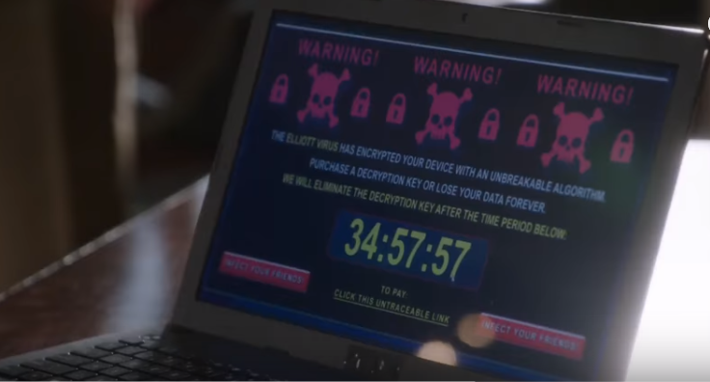
Ransomware
How is it Launched?
Opening an email or email attachment from someone you may or may not know and were not expecting
Visiting an unsafe, suspicious, or fake website
Clicking on a malicious or bad link in an email, on Facebook, Twitter, and other social media posts (like articles, videos, ads), and even instant messenger chats
Notes:
How is it launched?
You can get ransomware in a number of ways.
It can be launched via a phishing attack when you click on that link in the email or that attached file. Remember that attachments like pdf files can also launch malicious software.
You can also get it by visiting a compromised website. This can be done by clicking on ad. If you are reading the Tennessean online and see an ad for a product or service that you would like more information about, it is best to open a new browser window and search for the site rather than clicking on the link that could redirect you to a malicious site.
Clicking on links in social media posts can also launch ransomware.

Slide 18
Ransomware
What can I do?
Keep your operating system updated.
Use a reputable virus detection software and keep the definitions current.
Backup your data!!
Notes:
So what can you do?
Keep your operating system and other software updated. Remember that screenshot of ransomware that I just showed you. That was the WannaCry ransomware that was unleased a few years ago. It is estimated that it infected over 200,000 computers. It used an exploit that Microsoft had actually already corrected. However, because the victims had not kept their Windows operating system updated, they were infected.
Use antivirus software and keep it up to date.
Also, it is so important that you backup your data. If you have your data backed up to another location not connected to your network, you may be able to restore your files without having to pay the ransom.

Slide 19
Other important strategies
Develop security awareness training
Explore obtaining cyber insurance
Use strong passwords
Maintain a disaster recovery/business continuity plan
Notes:
There are also other policies and initiatives that you can put in place.
Do more of what you are doing today. Make sure that you and the others in your office participate in some type of security awareness training. You can subscribe to services that provide this type of training or you can seek out other resources such as presentations like this one at various events you may attend.
It is also important that you find out if you have insurance that will protect you against losses should you fall victim to an attack. And you need to know what kind of insurance coverage you have...Will the policy pay for expenses associated with the recovery from a cyberattack? Will the insurance company simply opt to pay a ransom minus a deductible instead of covering the costs associated with recovering your data? Will the policy cover credit monitoring if personal information is breached? Also keep in mind that some insurance companies are going to want to be sure you’re doing your due diligence to protect your systems, your data, and your money...There could be clauses in the insurance contract that say no coverage will be provided if a government’s shown to be careless or negligent in its cybersecurity practices. You should be aware of those clauses.
Use strong passwords. Best practices say that passwords should be at least eight characters but the longer the better. You also need to include numbers and symbols.
Also, it is important that you have a written plan to follow should you have an incident. Know who to call and how you can restore your data from backups if needed.

Slide 20
What if I am a victim?
Contact your IT department or vendor for assistance.
Contact your insurance company.
Report the attack to your local law enforcement agency.
If personal information has been breached, follow Section 47-18-2107, TCA
Notes:
What if I you are a victim?
Follow the steps you have outlined in your contingency plan. That plan should provide information for contacting your vendor or IT department, reporting the attack to law enforcement, and contacting the insurance company.
If the attacker has gained access to personal information you should follow Section 47-18-2107 of the TCA. This statute defines personal information and states what steps should be taken. Personal information for purposes of this statute is defined as first name or first initial and last name in combination with a social security number, a driver license number or a financial account number in combination with the security code or password that would allow access to the account. If you discover there has been a breach of this information you must disclose the breach to the affected persons within 45 days of discovery unless law enforcement feels there is a legitimate need to withhold this information. If notification involves more that 1,000 persons, you must also inform all consumer reporting agencies and credit bureaus.
And I would also like to add that I personally feel it is important to be mindful of how you respond to the individual that may have clicked on that link or visited that fictitious site that launched the attack. While it is so important that we stress the need to be cyber aware, we also need to refrain from shaming that individual. If you make an example of them so to speak, the next person that thinks they may have clicked somewhere they shouldn’t have will be much less likely to report it and that will give the attacker more time to wreak havoc. While the importance of being diligent should be stressed, you should be mindful of how you respond to the individual.

Slide 21
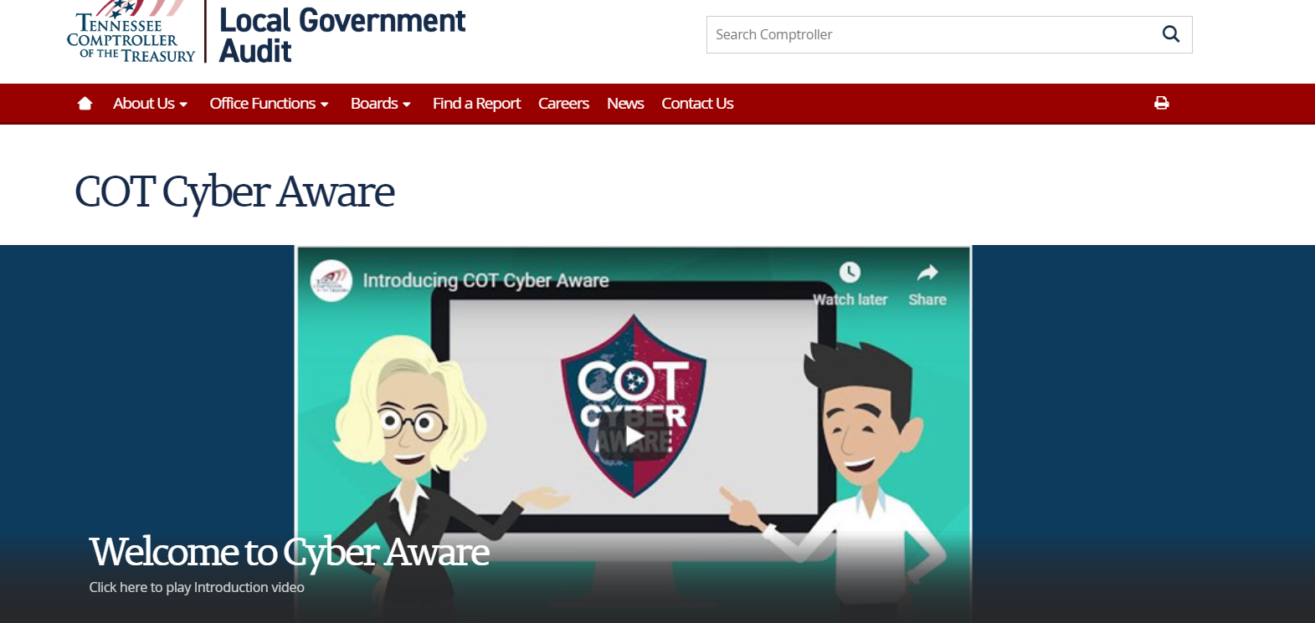
tncot.cc/cyberaware
Notes:
I just stressed the need for security awareness training. I want to spend the rest of our time introducing you to want we think is a good resource for that training. The Comptroller’s Office has developed a site that can be used to educate employees. We launched this site back in March and we continue to update it with more resources.
You can link to the site from the Comptroller’s main page or you can use the link provided to you in the event invitation email. The URL is also presented at the top of this slide. TNCOT.cc/Cyberaware

Slide 22
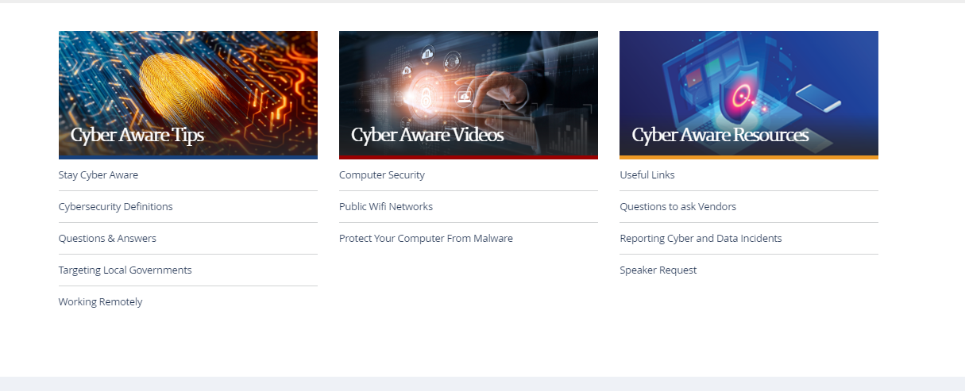
tncot.cc/cyberaware
Notes:
There’s 3 main sections to our website...Cyber Aware Tips, Cyber Aware Videos, and Cyber Aware Resources.

Slide 23
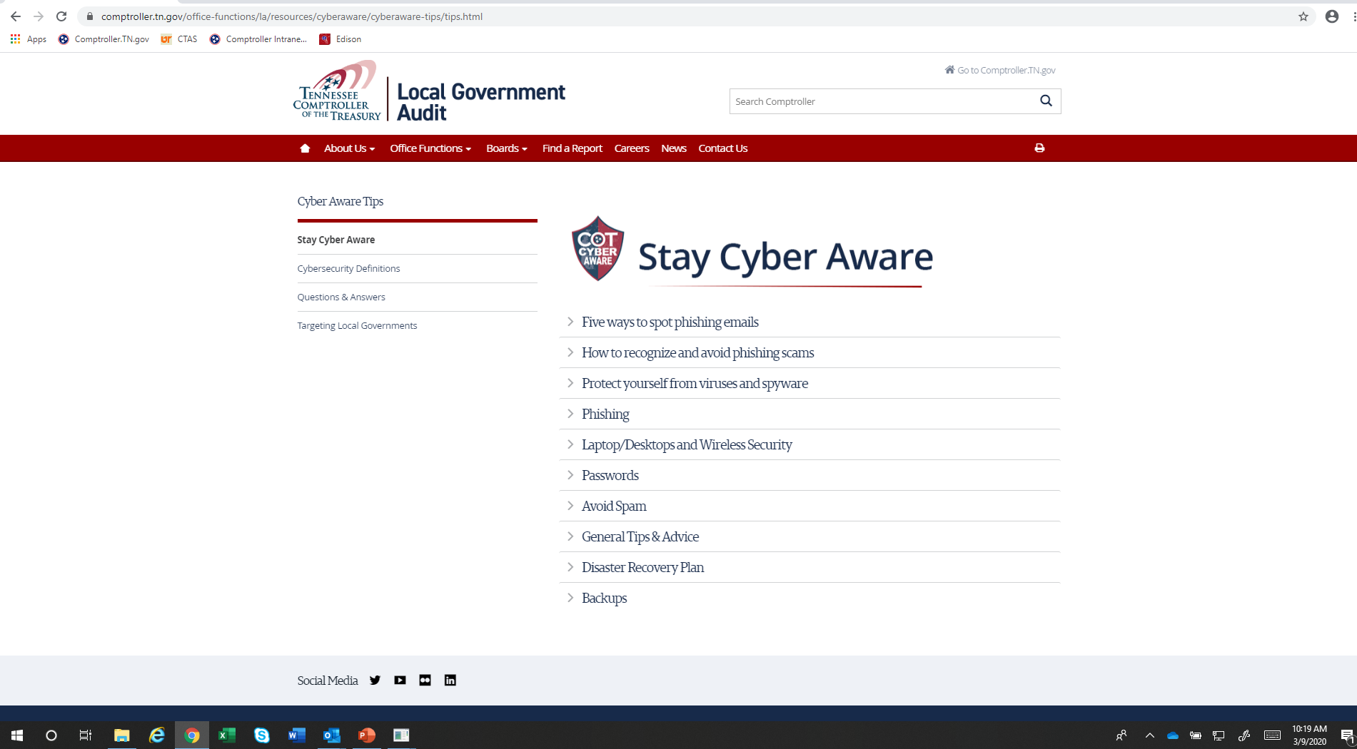
tncot.cc/cyberaware
Notes:
Under Cyber Aware Tips, you’ll find information on how to spot phishing e-mails., how to secure laptops and wireless networks, advice on establishing strong passwords, information about disaster recovery plans. and the importance of good, clean system backups.
There’s a link to definitions of viruses, spyware, ransomware, and spam.
There’s also a Q&A section and a link to news stories related to cyberattacks in Tennessee.

Slide 24
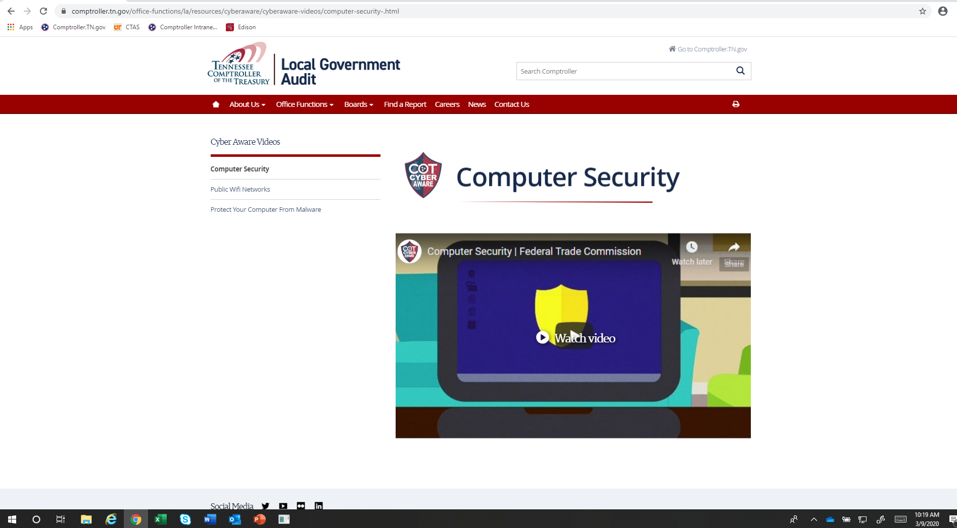
tncot.cc/cyberaware
Notes:
Under Cyber Aware Videos you’ll find some short instructional videos on computer security, public WiFi networks, and malware.
We will also be posting today’s webinar here so that anyone who could not attend today, can view it at their convenience.

Slide 25
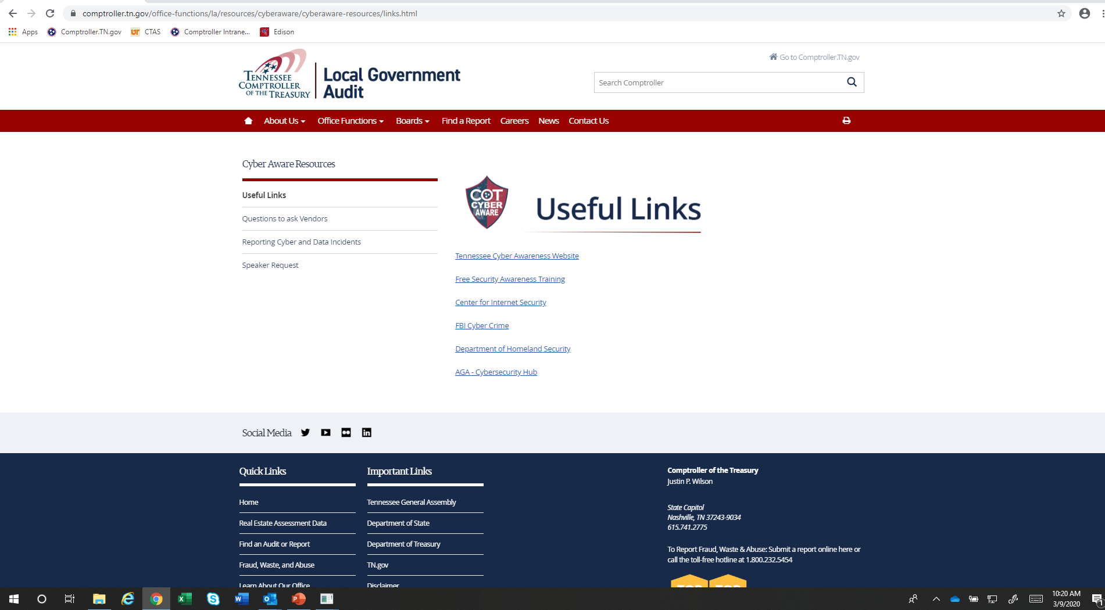
tncot.cc/cyberaware
Notes:
Under Cyber Aware Resources there’s a link to some free security awareness training offered by the Federal Department of Health and Human Services. There’s a link to the State of Tennessee’s cyber awareness site. You’ll also find links to questions you should ask your hardware and software vendors. I know that many local government offices do not have an internal IT person and rely heavily on the county or city’s IT department or upon their accounting software vendor for their computer operations. It is important that you as the department head or official understand the safeguards that are in place to protect your information systems, so it is important that if you do not know the answers to these questions you consult with the IT staff or vendor to find the answers.
Questions address how software is updated and if backups are configured so that they would not be vulnerable to a ransomware attack as well some more technical questions regarding firewalls and wireless networks. I really encourage you to go out and view those questions and find the answers.
And there’s a link where you can report a cyberattack or data breach to the Comptroller and to the FBI...
There is also a link to request a speaker. If you all would like someone from our office to come to your location when it is again safe, we would be happy to discuss security awareness with a group of local government employees.
I encourage everyone to use this site as an education tool for your office staff.

Slide 26
In Conclusion
Penny Austin
Penny.Austin@cot.tn.gov
615-401-7838
tncot.cc/cyberaware
Notes:
So, in wrapping up my remarks today, I hope you can now see that cybersecurity’s really all about you...It’s not just a technology thing.
We’ve all got to be educated on how to spot cybersecurity threats and have a plan for responding if we’re attacked.
Here’s my contact information if you would like to reach out with any questions or comments.

