Slide 1
Federal Education Funding Task Force
Office of Research & Education Accountability
Presented 11.6.23
Updated 12.7.23

Slide 2
Federal funding to the Tennessee Department of Education | 1968-2022
Notes:
This shows the history of total federal funding by the TN Dept of Education (the red line) and total funding from all sources (the blue line). Most federal education funds flow through the state and then out to the local districts as subgrants..
It does not reflect federal funds that are awarded directly to the districts or funds that are awarded to other state agencies, such as IDEA funds for infants and toddlers that have been awarded to the Dept of Intellectural & Developmental Disabilities (DIDD) since FY 2021.

Slide 3
Federal funding to the Tennessee Department of Education | 1968-2022
Notes:
This shows the same data, but with the federal funds as a percent of total Dept of Education funds. The spikes in Fy 2010 and 2011 reflect ARRA funds during the Great Recession and the Race to the Top grant. The spike to the far right in FY 2022 reflects the various COVID relief funds awarded.

Slide 4
How much does Tennessee receive?
Formula grants for education (recurring, allocated to all the states based on a formula)
2022 allocation = $1.44 billion
2023 allocation = $1.29 billion
These totals do NOT include one-time grants or COVID-relief funds.
Notes:
Also 2023 included $15.9 million in Charter School program grants that were not part of the 2022 formula award. During the pandemic, the federal government was reimbursing school breakfasts, lunches, and snacks to all students, free of charge, instead of only those eligilble for free or reduced price meals.

Slide 5
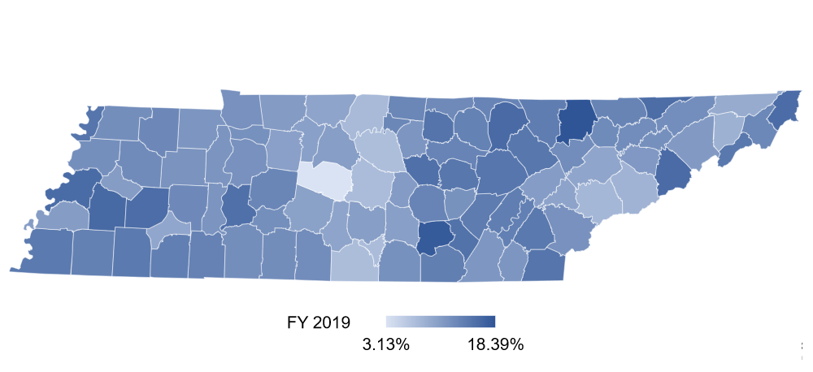
Where does the money go?
The bulk of federal education funds are passed through to LEAs.
FY 2018-19 | Percentage of district current revenues from federal funds
Statewide rate = 11.14%
New map FY 2019 only
Notes:
City and special school district federal funds data is combined with the county school district data in counties with more than one school district. The state special school districts, DCS, and DOC also receive federal funds, which are not reflected in this map.

Slide 6
Percentage of county education revenues from federal funds | FY 2018-19
Top Ten | Federal funds revenues |  | Bottom Ten | Federal funds revenues
Campbell | 18.39% |  | Williamson* | 3.13%
Grundy | 17.73% |  | Wilson* | 7.14%
Haywood | 16.18% |  | Lincoln* | 7.22%
Fentress | 16.09% |  | Moore | 7.30%
Cocke* | 15.98% |  | Rutherford* | 7.32%
Lauderdale | 15.96% |  | Sumner | 7.59%
Johnson | 15.88% |  | Blount* | 7.82%
Hancock | 15.84% |  | Sevier | 8.28%
Madison | 15.77% |  | Washington* | 8.55%
DeKalb | 15.47% |  | Sullivan* | 9.19%
*County that contains more than one LEA
Federal funds tend to make up a higher percentage of school district revenues in lower income and rural areas.
Federal funds tend to make up a lower percentage of school district revenues in more affluent areas.
Notes:
Counties with multiple school districts (*)have been combined in the map and table. We have a list of figures for each school district in the state if the working group would like that information.

Slide 7
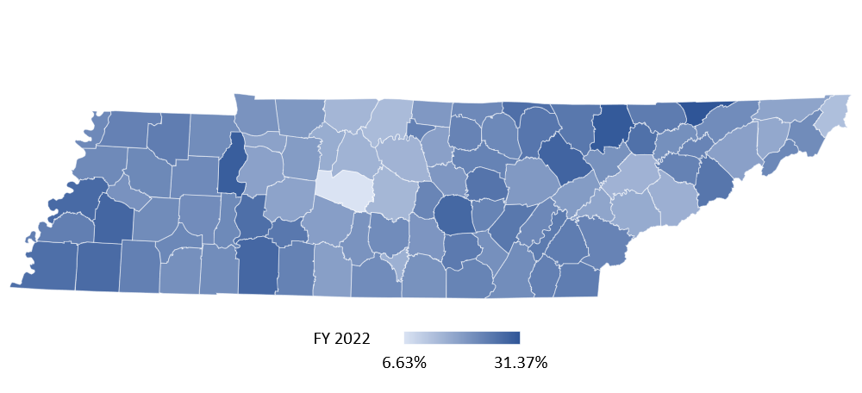
Where does the money go?
The bulk of federal education funds are passed through to LEAs.
FY 2021-22 | Percentage of district current revenues from federal funds
Statewide rate = 19.54%
New map Fy 2022 only
Notes:
City and special school district federal funds data is combined with the county school district data in counties with more than one school district. The state special school districts, DCS, and DOC also receive federal funds, which are not reflected in this map.

Slide 8
Percentage of district current revenues from federal funds | FY 2021-22
Top ten | Federal funds revenues | Bottom ten | Federal funds revenues
Hancock | 31.37% | Williamson* | 6.63%
Campbell | 30.58% | Johnson | 12.94%
Benton | 29.87% | Sumner | 13.59%
Morgan | 28.79% | Rutherford* | 14.34%
Haywood | 28.38% | Robertson | 14.48%
Wayne | 28.19% | Wilson* | 14.94%
Warren | 28.13% | Davidson | 14.95%
Lauderdale | 27.69% | Knox | 15.08%
Fayette | 27.52% | Moore | 15.57%
Shelby* | 26.89% | Sevier | 15.60%
*County that contains more than one LEA
Notes:
Counties with multiple school districts (*)have been combined in the map and table. We have a list of figures for each school district in the state if the working group would like that information.

Slide 9
The five largest grant categories of federal formula funds are:
Title I (for disadvantaged students)
IDEA (for students with disabilities)
Child Nutrition (for school lunches, breakfasts, snacks, and milk)
Title II (supporting effective instruction)
Perkins V (for career & technical education, or CTE)
These five accounted for 95 percent of all 2023 Tennessee formula fund allocations.
Notes:
And the top 3 are by far the largest accounting for 86% of 2023 formula fund allocations.

Slide 10
Title I (for disadvantaged K-12 students)
Title I is the largest part of the federal Every Student Succeeds Act of 2015 (ESSA).
Title I includes four main subsections:
Part A – Additional funds to improve education outcomes for students from low-income families
Part B - State assessment grants
Part C - Education of migratory children
Part D - Prevention and intervention programs for children and youth who are neglected, delinquent, or at-risk
Both federal and state law include requirements for academic standards, annual state assessments, and an accountability system for school performance.
Federal law for these grants also requires a comprehensive state plan for using federal dollars, as well as district and school level plans.
Notes:
(State law in addition to federal law requires LEA and school plans.)

Slide 11
Title I funding by category
 | 2019 | 2020 | 2021 | 2022 | 2023
Part A | $309,747,093 | $308,798,568 | $328,541,302 | $323,379,041 | $349,663,715
Part B | $7,243,602 | $7,259,912 | $7,277,865 | $7,292,324 | $7,319,958
Part C | $1,374,844 | $1,272,535 | $1,616,588 | $1,703,420 | $1,394,130
Part D | $227,554 | $297,828 | $250,429 | $243,407 | $277,419
Total | $318,593,093 | $317,628,843 | $337,686,184 | $332,618,192 | $358,655,222

Slide 12
Individuals with Disabilities Education Act (IDEA)
 | 2019 | 2020 | 2021 | 2022 | 2023
Part B (ages 3-21) | $ 256,263,704 | $ 257,900,245 | $ 265,485,438 | $ 268,713,861 | $ 281,527,548
Part C (ages birth-2) | $ 9,068,956 | $ 9,133,835 | $ 9,268,221 | $ 9,545,763 | $ 10,758,600
Total | $ 265,332,660 | $ 267,034,080 | $ 274,753,659 | $ 278,259,624 | $ 292,286,148
Both IDEA and state law require:
an individualized education program (IEP) be prepared for each student with disabilities, setting academic goals and special education services and accommodations the school will provide; and
schools to educate students in the least restrictive environment, e.g., keeping students in regular classrooms whenever possible.
Other federal requirements include state and local maintenance of effort, identification and screening of all children who may be eligible, and sharing funds with private schools.
Notes:
Part B totals here include both the main grant for K-12 schools (Part 619) and the smaller grant for preschool services for ages 3-5 (Part 611). The Part C program – early intervention services – has recently expanded in Tennessee. While it is required to provide home and community based services to children birth through age 2, TN is one of a handful of states that expanded services to children through age 3, and, this year, is the first in the nation to expand services until a child turns 5 or starts kindergarten. Extra federal funds are provided on a year-to-year basis [not shown in the chart] for these service extensions to provide more options for parents.

Slide 13
USDA Child Nutrition funds
 | 2019 | 2020 | 2021 | 2022 | 2023
National School Lunch Program, School Breakfast, summer program, snacks | $403,300,000.00 | $264,963,421.02 | $457,208,628.53 | $685,477,813.00 | $474,887,445.00
State Administrative | $3,442,864.00 | $2,583,481.00 | $2,933,864.00 | $3,031,325.79 | $4,780,247.00
NSLP Equipment | $732,518.01 | $704,231.00 | $687,791.00 | $811,898.00 | $2,144,289.00
Fruit & Vegetable | $3,399,043.50 | $3,064,420.79 | $3,949,423.00 | $4,687,875.00 | $4,800,064.00
Total | $410,874,425.51 | $271,315,553.81 | $464,779,706.53 | $694,008,911.79 | $486,612,045.00
Child nutrition programs accounted for over a third of federal formula funding in 2023.
With the State Administrative Expense funds, TDOE employs 21 full-time staff to administer school nutrition programs, including 10 who work regionally to support local school food authorities.
School districts are reimbursed based on the number of meals served and at rates determined by whether the child paid full price or was eligible for free or reduced-price meals.
Meals must meet certain nutritional guidelines (e.g., ½ cup fruit, ¾ cup vegetables, etc.).

Slide 14
Title II (supporting effective instruction)
 | 2019 | 2020 | 2021 | 2022 | 2023
Allocation | $36,482,619.00 | $37,879,390.00 | $41,689,376.00 | $42,693,753.00 | $45,546,902.00
Title II, Part A, authorizes formula grants for improving teacher and principal quality. States may use the funds to assist districts in improving teacher and principal evaluation programs, reforming teacher and principal certification programs, and expanding alternative certification options.
In 2020-21, almost all Tennessee LEAs (96 percent) used Title II-A Funds for professional development.
Other uses of the funds included recruiting, hiring, and retaining effective educators (42 percent of LEAs); class size reduction (7 percent of LEAs); and evaluation systems (8 percent of LEAs).

Slide 15
Perkins V
(for career and technical programs, or CTE)
 | 2019 | 2020 | 2021 | 2022 | 2023
Allocation | $25,432,004.00 | $26,916,562.00 | $27,353,102.00 | $28,502,865.00 | $29,506,984.00
Perkins V funds provide supplemental resources to support the academic, career, and technical skills of secondary students who elect to enroll in career and technical education programs.
In FY 2021-22, 122 school districts received a portion of $20.67 million in federal funds that were distributed through the state.
The state may use Perkins V funds to cover administrative costs, including developing its state plan, reviewing local applications, and monitoring and evaluating program effectiveness.
School districts may use Perkins funds to improve career and technical education programs, including modernizing, revising, expanding, or upgrading CTE programs.

Slide 16
Summary of 2023 federal funding allocations
Formula grant programs of recurring nature | 2023 Allocation
Title I (for disadvantaged students) | $358,655,222
IDEA (individuals with disabilities) | $292,286,148
USDA Child Nutrition | $486,612,045
Title II (supporting effective instruction) | $45,546,902
Perkins V (career and technical education, or CTE) | $29,506,984
Other programs not here detailed | $79,426,733
Total | $1,292,034,034
Notes:
Other formula grants include Title III (English language learners), Title IV (after school programs and Safe & Healthy schools), Title V (Rural and Low income schools), Charter School Program (Title IV-Part C), Title IX (Homeless)

Slide 17
Next Steps
Inventory of data, presentations, questions, and answers.
Assist in obtaining answers to any additional questions from the task force.
Prepare a summary of task force meetings and provide to the task force.

